Slide 1
Object Oriented Programming Lecture-9
Arrays in Java: Arrays in Java, initialization, Default Array values, multi dimensional array
Prof. Varsha Dange

Slide 2
Arrays in Java
Array in Java is a container that holds a group or collection of elements of a similar data type.
an array is a fixed-size data structure that is used to hold more than one value of the same data type.
Elements of an array in java are stored in a contiguous memory location.
we can store a fixed set of elements in an array.
In Java all arrays are dynamically allocated.
Since arrays are objects in Java, we can find their length using the object property length. This is different from C/C++ where we find length using sizeof.

Slide 3
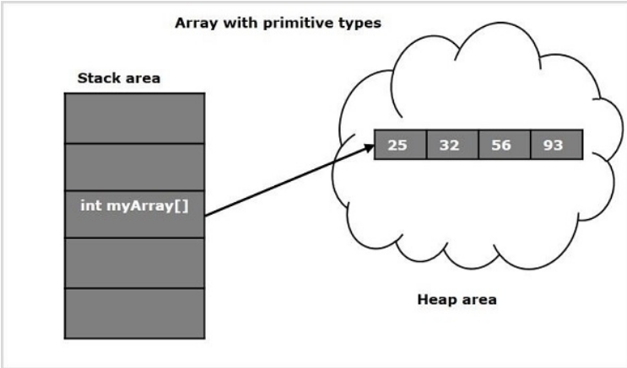
Arrays in Java
A Java array variable can also be declared like other variables with [] after the data type.
The variables in the array are ordered and each have an index beginning from 0.
The direct superclass of an array type is Object.
Arrays can be created for primitive as well as non primitive data types.
the reference types in Java are stored in heap area.
Since arrays are reference types (we can create them using the new keyword) these are also stored in heap area.

Slide 4
Advantages of Arrays in Java
1. The main advantage of array-based structure is that it organizes data in such a way that it can be easily manipulated.
2. We can access randomly nth element in an array at a constant time.
3. Arrays optimizes the code, thereby, we can retrieve or sort the data efficiently.

Slide 5
Disadvantages of Arrays in Java
1. Since arrays are fixed in size, we can store only the fixed size of elements in the array.
2. Once the size of an array is created, it cannot be changed.
That is, an array cannot expand or shrink at runtime.
To solve this problem, Java has introduced the collection Framework which grows automatically.
3. We cannot store different kinds of elements in an array.
For example, A primitive array of int will only store the values of int type.
An array of an Employee class will store only Employee type objects.

Slide 6
Types of Arrays in Java
arrays are categorized into two forms that are as :
Single dimensional arrays (or 1D array called one-dimensional array)
Multidimensional arrays (or 2D, 3D arrays)

Slide 7
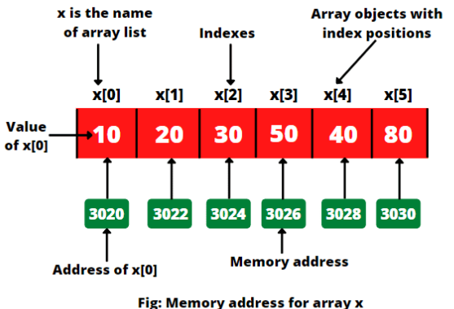

One dimensional Array (or Single dimensional Array)
A one-dimensional array contains a element of the same type and is accessed through a common name.
Each element in the array is represented by an array name with its index or subscript enclosed in a square bracket [ ].
A single-dimensional array can have only one full row or full column of elements.

Slide 8
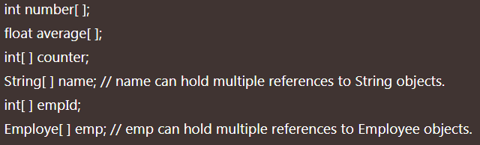
initialization /declaration of an Arrays in Java
The general syntax for declaring an array variable in java comes in two forms:
dataType var-name[]; or
dataType[] var-name;
Declaration of an Array:

Slide 9
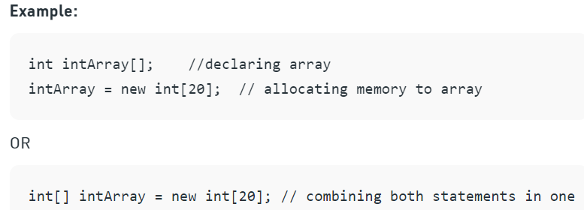
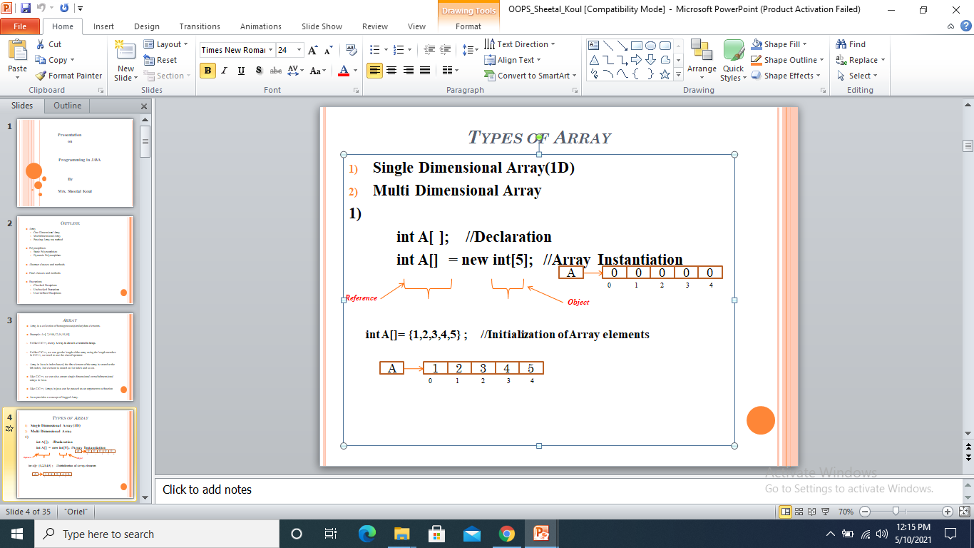
Instantiating an Array in Java
When an array is declared, only a reference of array is created.
To actually create or give memory to array, have to create an array like this:
var-name = new dataType [size]

Slide 10
Default Array values
The elements in the array allocated by new will automatically be initialized to zero (for numeric types), false (for Boolean), or null (for reference types).
Example
in Java all arrays are dynamically allocated.
We can also declare array as –
int [] intArray ={1,3,4,7,8};
The length of this array determines the length of the created array.

Slide 11
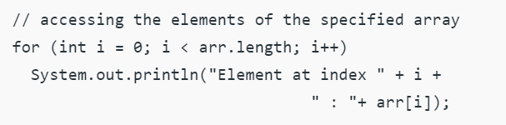
Accessing Java Array Elements using for Loop
Each element in the array is accessed via its index.
The index begins with 0 and ends at (total array size)-1.
All the elements of array can be accessed using Java for Loop.
Example1
Example2
WAP in Java that will take no. of subjects and marks for subjects . Calculate total and display percentage.

Slide 12
Accessing Java Array Elements using foreach Loop
You can also access java arrays using foreach loop.
it starts with the keyword for like a normal for-loop.
Instead of declaring and initializing a loop counter variable, you declare a variable that is the same type as the base type of the array, followed by a colon, which is then followed by the array name.
In the loop body, you can use the loop variable you created rather than using an indexed array element.
It’s commonly used to iterate over an array or a Collections class (eg, ArrayList)

Slide 13
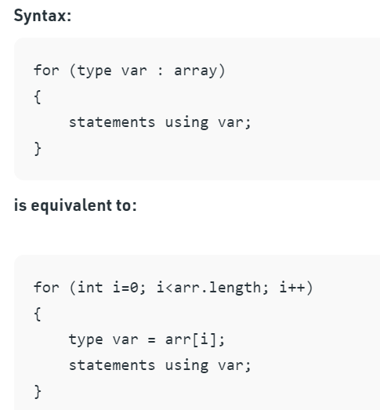
Accessing Java Array Elements using for each Loop
Example1
Example2 (Array of Object)

Slide 14
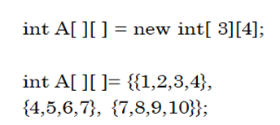

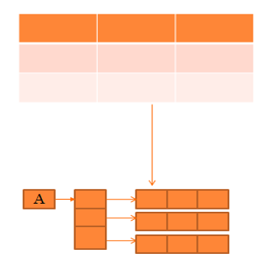
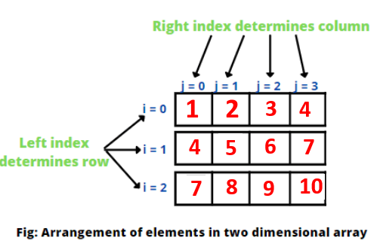
Two Dimensional Array
Java Multi Dimensional Arrays are basically array of arrays. A multidimensional array is a nested array; an array-within-an-array
A two dimensional array in java represents many rows and columns of data.
Data in matrix or table form can be represented by using two dimensional array.
How to Declare and Initialize Two Dimensional Array in Java
Example
This 2D array contains three one-dimensional arrays. So, it is called multidimensional arrays in java.

Slide 15
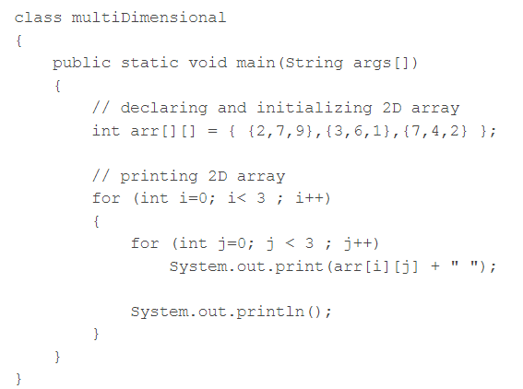
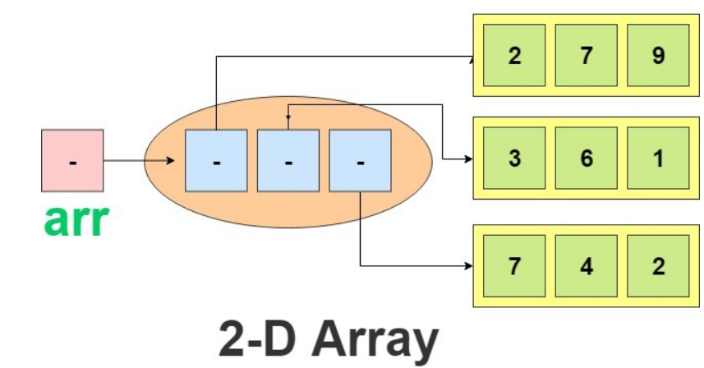
Two Dimensional Array

